Slide 1

Think You’re Stealthy? How to Detect Attacks in AD
Aakash Raman - UMD Alumni; Associate Detection Engineer
Sai Sathvik Ruppa - Student at Carnegie Mellon University
Rachit Arora - Student at University of Maryland

Slide 2
Thinking like a Detection Engineer
If you're going to detect a malicious activity, we really need to understand how it works; Without that understanding, any detection approach we take will inevitably be naive based more on guesswork than on actual knowledge of the behavior you're trying to identify.
Understand the Technique
Know the Tools and APIs
System Artifacts
Analyze Network Indicators

Slide 3


BloodHound
BloodHound maps hidden relationships in Active Directory to reveal potential paths for lateral movement and privilege escalation.
The tool itself is simply an analysis tool, and does not actually execute any attacks. It gets its data from SharpHound.
BloodHound is only as powerful as the data it receives without data, it has nothing to analyze.

Slide 4
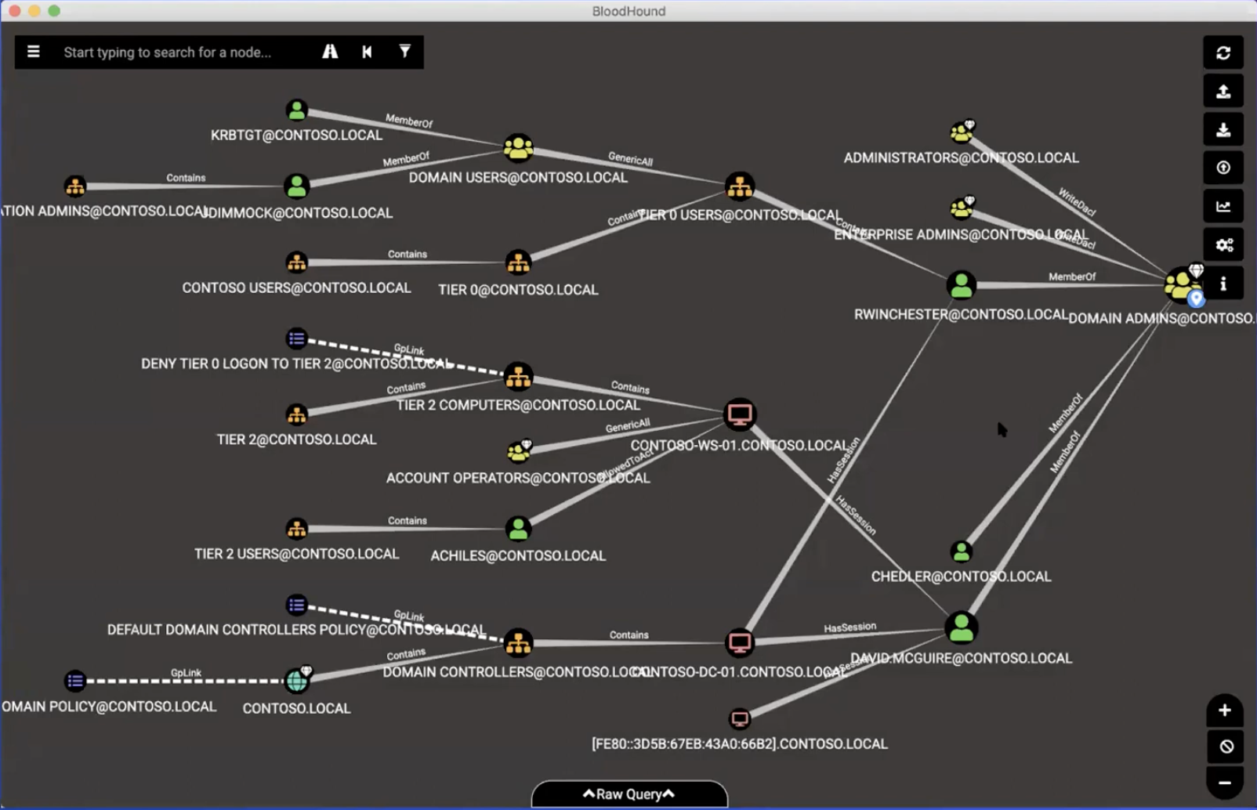
BloodHound graph populated using SharpHound data collection results.

Slide 5
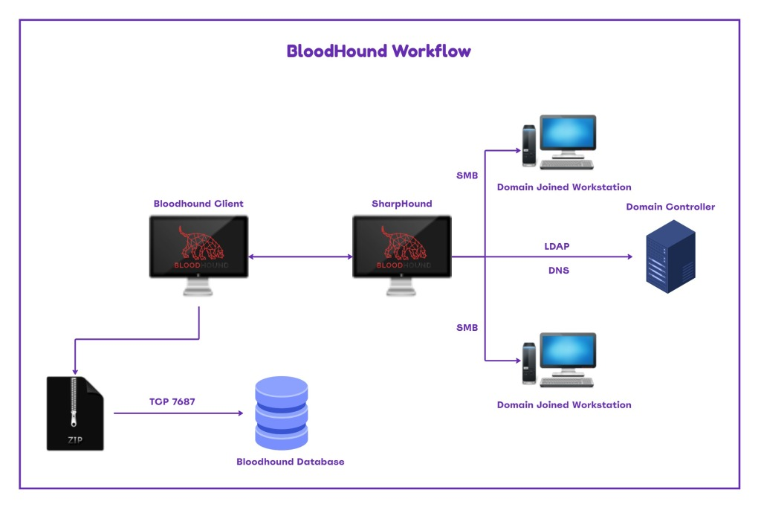
SharpHound
SharpHound runs on a compromised domain-joined machine, collecting data from Domain Controllers (via LDAP/DNS) and all domain-joined endpoints (via RPC over SMB).
Collected data is packaged into a .zip file containing relationship mappings (users, sessions, groups, ACLs, trusts, etc.).
The .zip is imported into the BloodHound GUI, where it’s parsed into a graph database revealing attack paths for red teams or exposure points for blue teams.
source: https://ipurple.team/

Slide 6
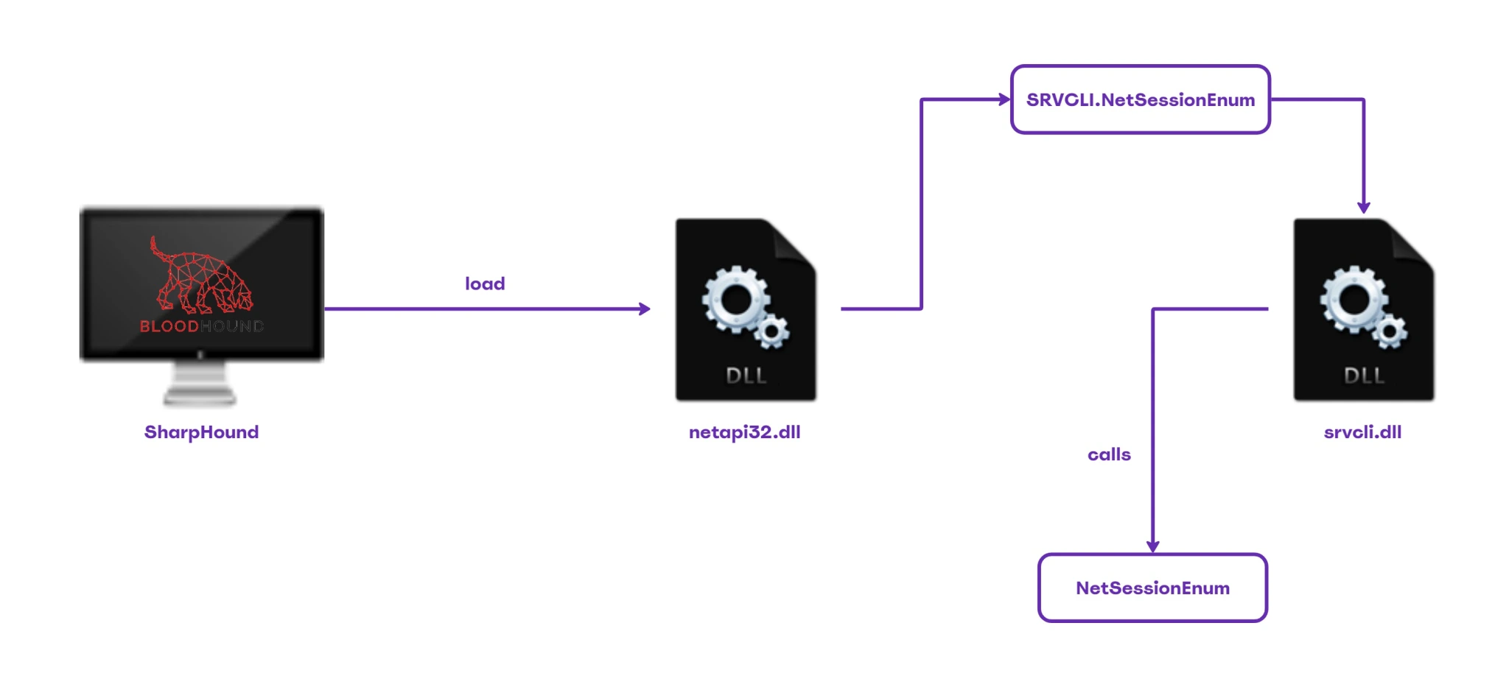
SharpHound APIs
SharpHound often loads netapi32.dll on execution; reliable detection needs layered defenses due to obfuscation and tool variants.
Tweak your EDR product monitors these API calls to detect active directory reconnaissance at an API level.
Unlike traditional tools, bloodhound.py directly calls the NetRSessionEnum RPC procedure over the network.
It skips higher-level Windows API calls (like NetSessionEnum via netapi32.dll), avoiding common EDR detections.
source: https://ipurple.team/

Slide 7
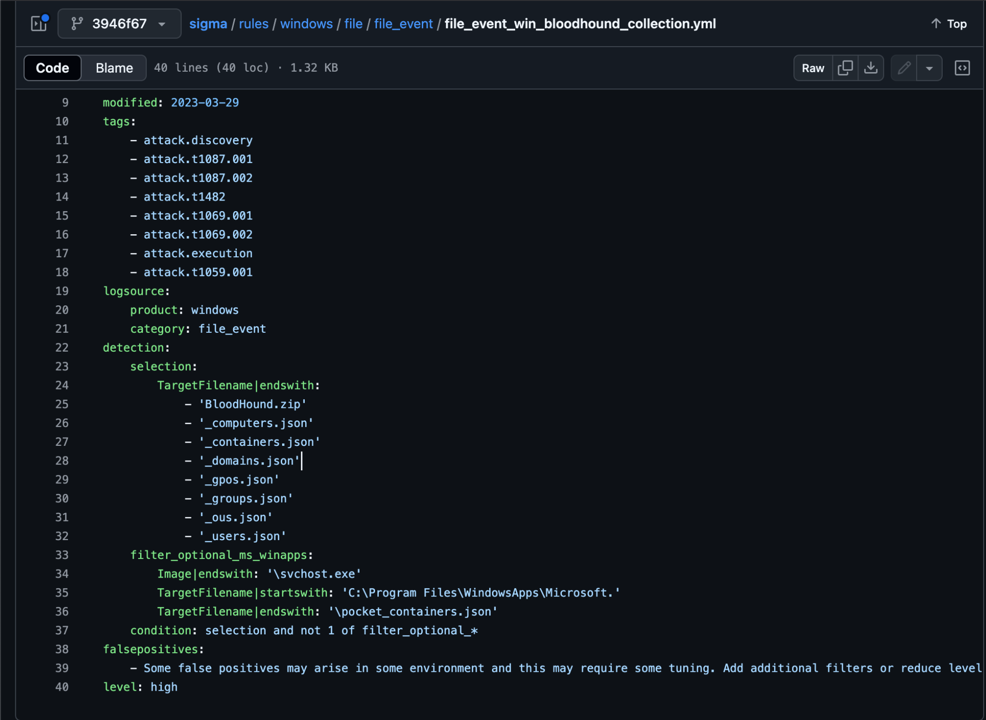
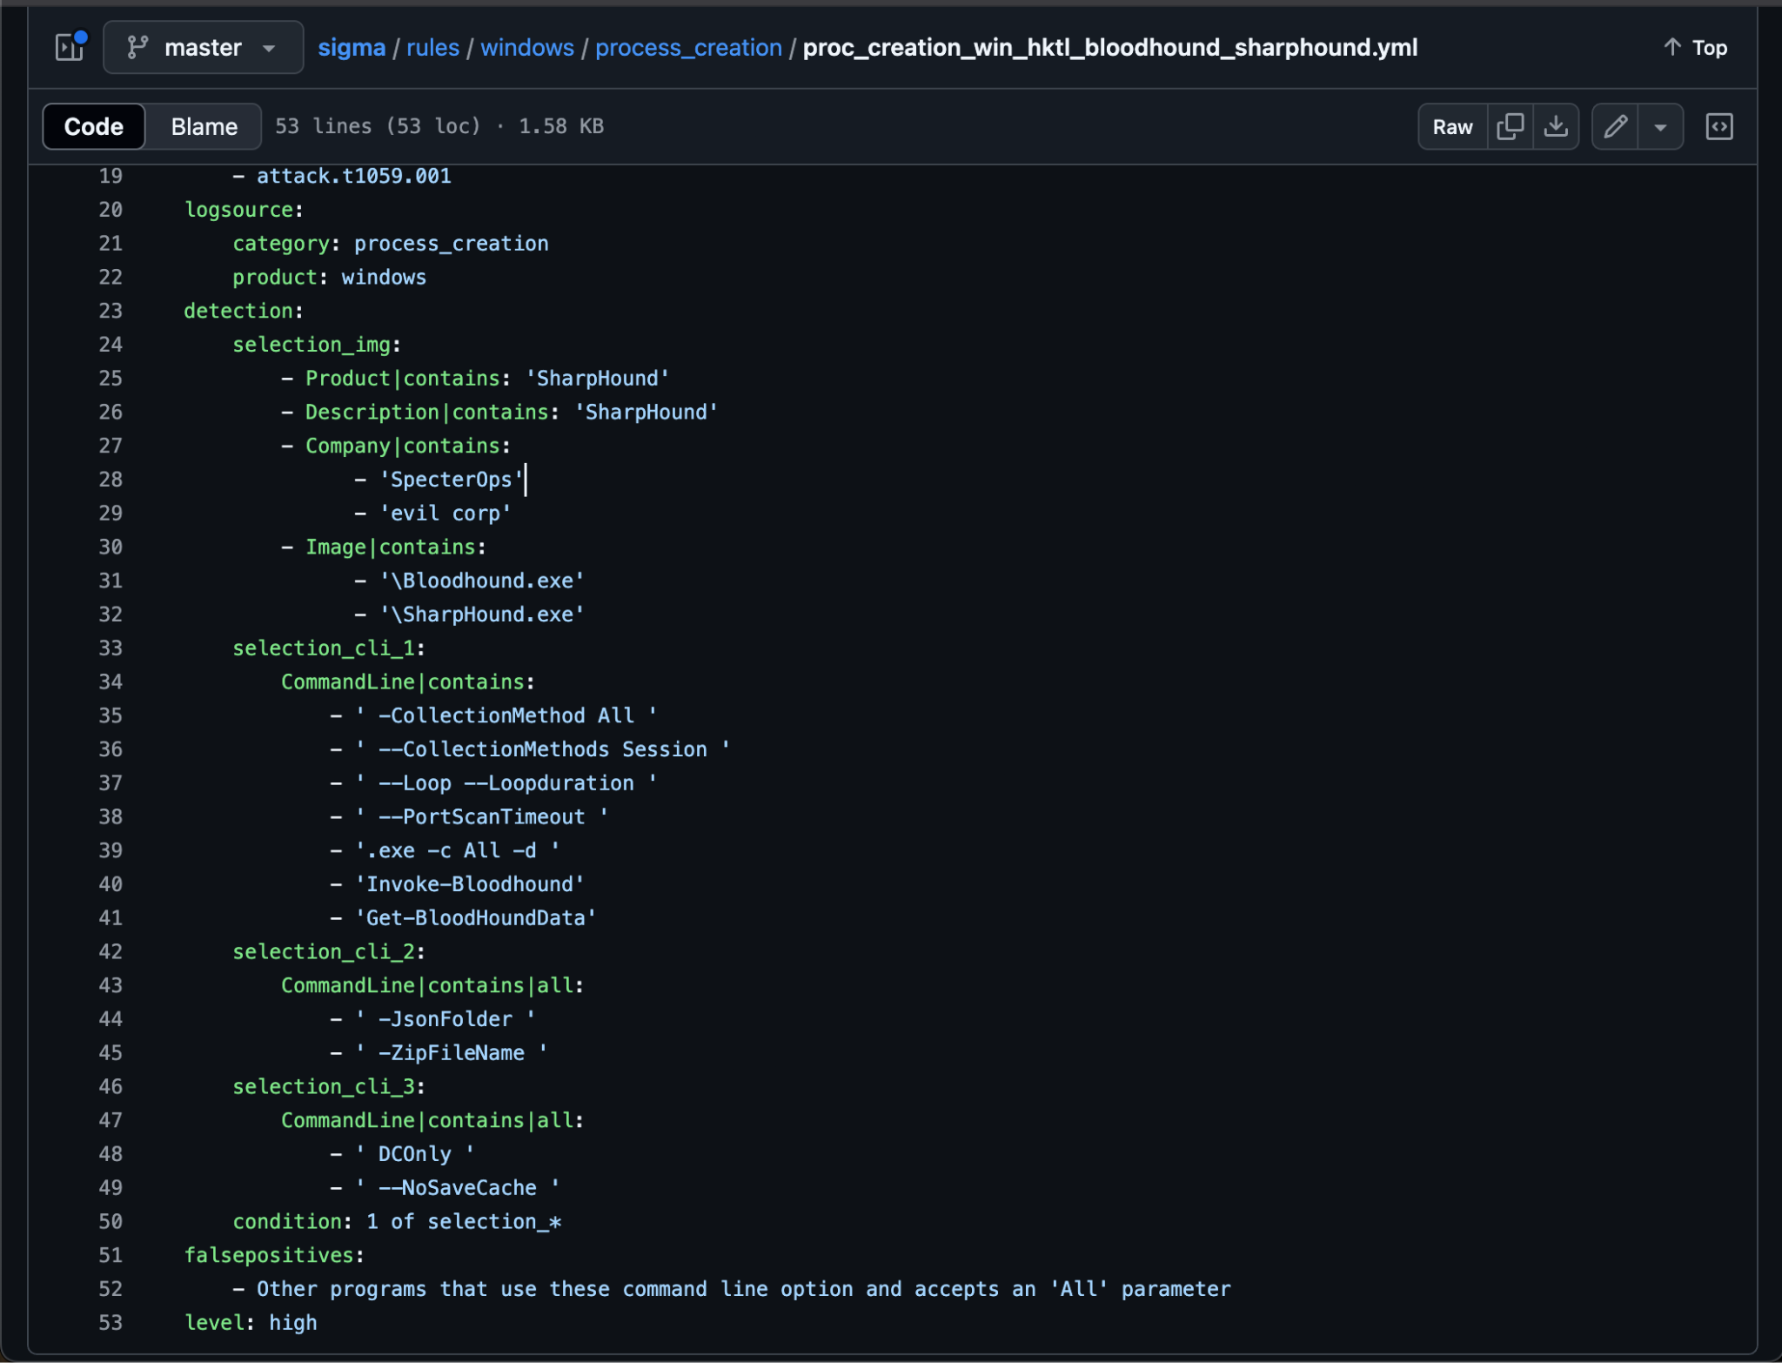
BloodHound Detection - Quick Wins
Detecting the default use of SharpHound, like the -CollectionMethod All flag, can provide quick and accurate results.

Slide 8
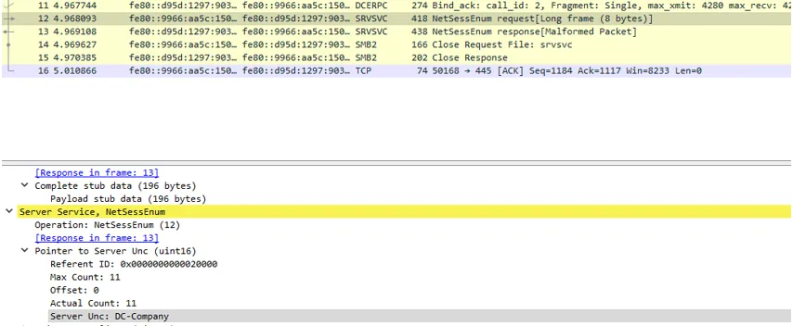
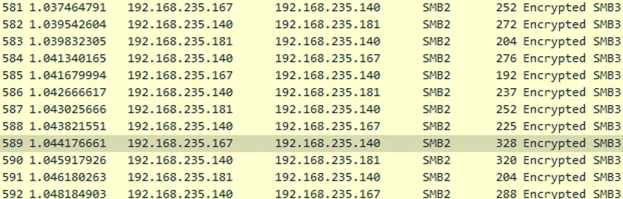
Bloodhound.py - Interesting Case
There are multiple variations of SharpHound, including Get-NetSession, NetSess, Rusthound, and Impacket-based implementations like bloodhound.py.
Tools like SharpHound and NetSess use RPC calls such as NetSessionEnum over SMB to enumerate active user sessions on remote systems within a domain.
We assumed that bloodhound.py would generate detectable RPC traffic during session enumeration, similar to other tools.
However, it uses the Impacket library with SMB3, which encrypts the traffic making RPC operations like NetSessionEnum invisible to network-based detection.
source: https://medium.com/mercadonait/how-to-hear-the-bloodhound-barking-5ac290427b17

Slide 9
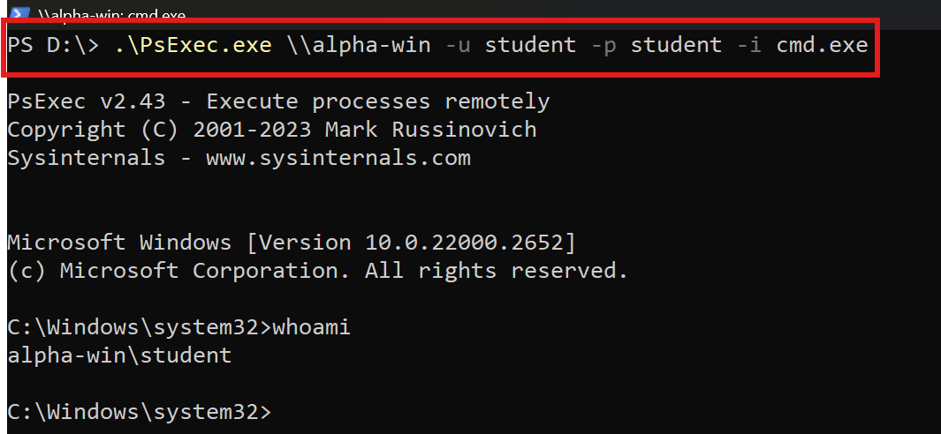
PsExec - Lateral Movement
MITRE ATT&CK ID: S0029
A Sysinternals utility to run commands on remote Windows machines
Found in toolkits like Cobalt Strike, Metasploit, and Impacket
PsExec Working:
Authenticates over SMB using credentials
Copies PSEXESVC.exe to “\\<target>\admin$\system32”
Creates and starts a remote service (PSEXESVC)
Uses named pipe (\\.\pipe\psexesvc) for communication
Cleans up: Deletes service & binary after execution
- Example Usage:
- psexec.exe -accepteula \\HOSTNAME cmd.exe
- psexec.exe -accepteula -r customsvc \\HOSTNAME -i powershell.exe

Slide 10


Slide 11
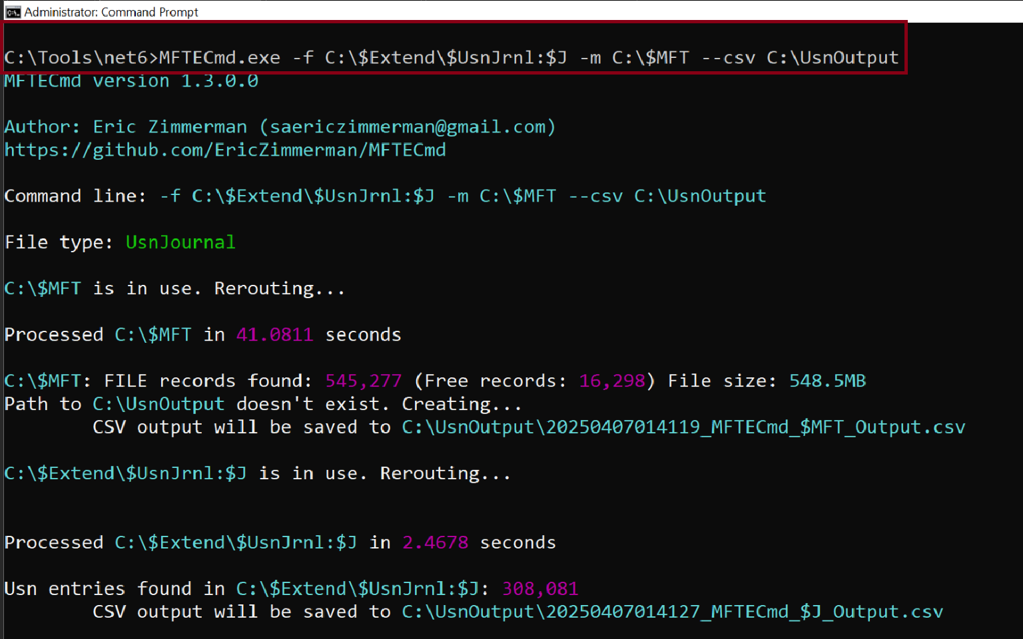
Noteworthy Detection Artifact: PSExec in USN Journal
New Artifact 1: PSExec Key File (inside USN Journal from v2.30 onwards)
USN Journal: Feature of Windows NTFS File system -> maintains log of all changes made to the volume
Naming Convention: “PSEXEC-[Source Hostname]-[8 Unique Characters].key” & Location -> “C:\Windows”
Command: MFTECmd.exe -f C:\$Extend\$UsnJrnl:$J -m C:\$MFT --csv C:\UsnOutput

Slide 12
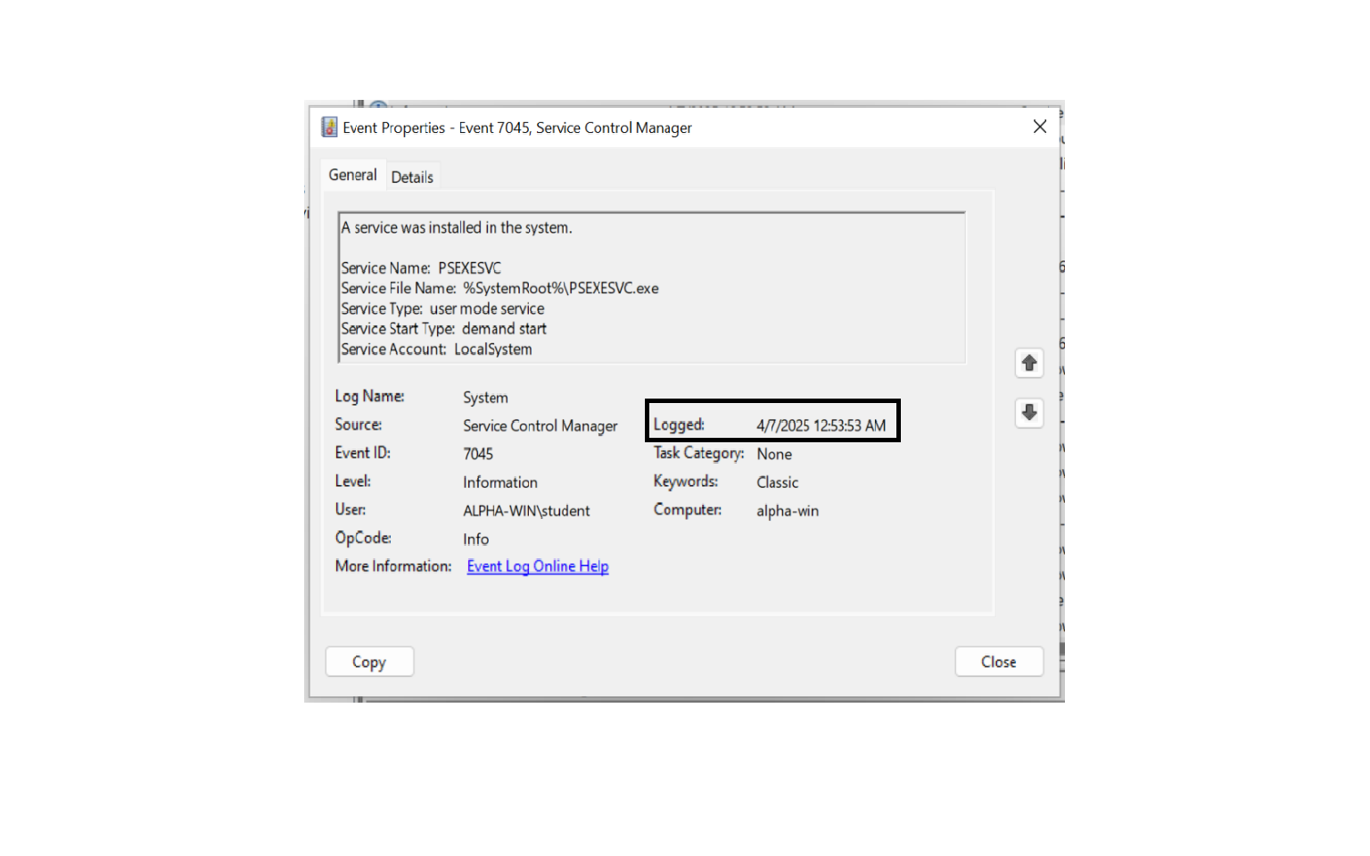
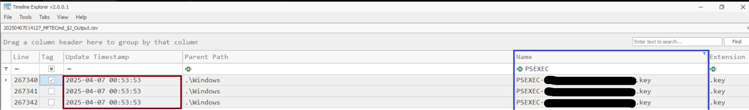
Correlating Windows Event Logs + Timeline Explorer for PSExec Activity

Slide 13
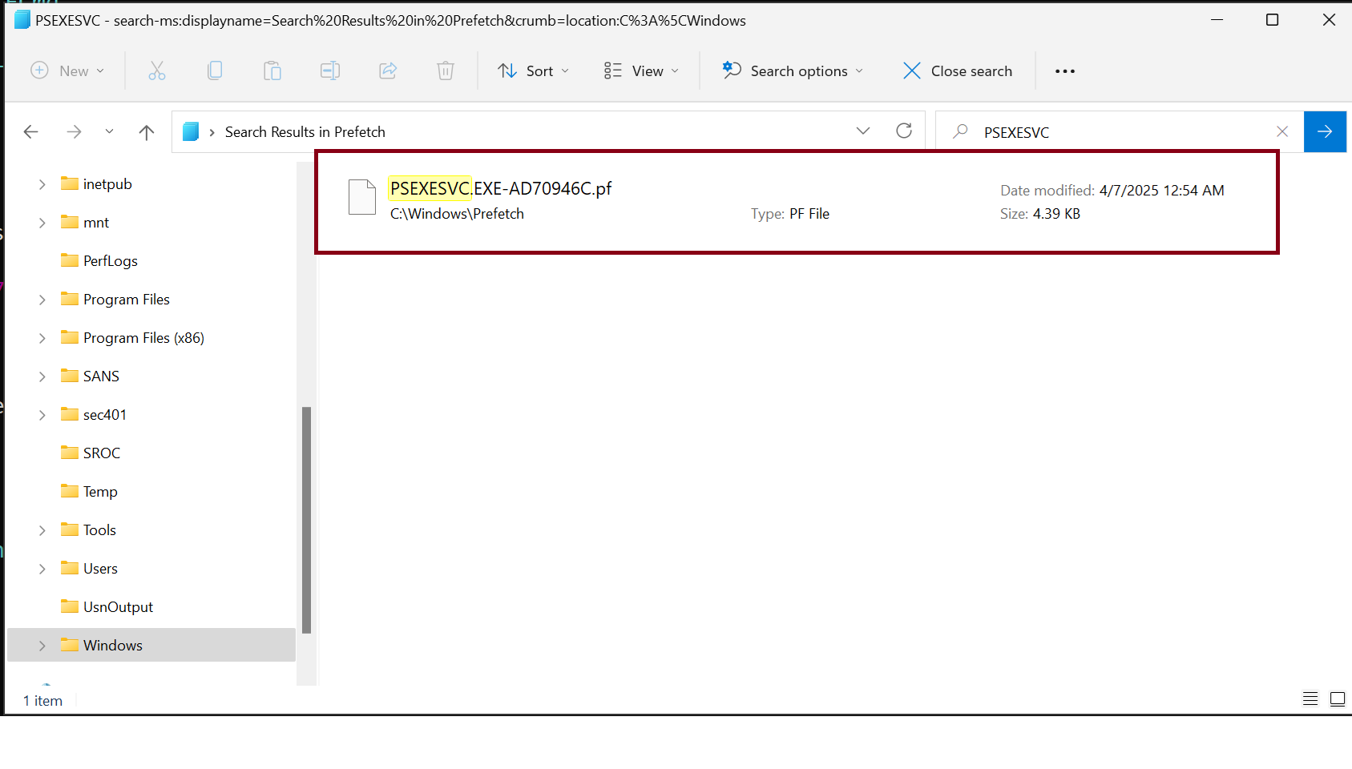
Noteworthy Detection Artifact: PSExec in Prefetch Files
New Artifact 2: PSExec Key File (inside Prefetch Files from v2.30 onwards)
Prefetch Files: Evidence of Execution Artifact in Windows
Default Location of Prefetch files: “C:\Windows\Prefetch”

Slide 14
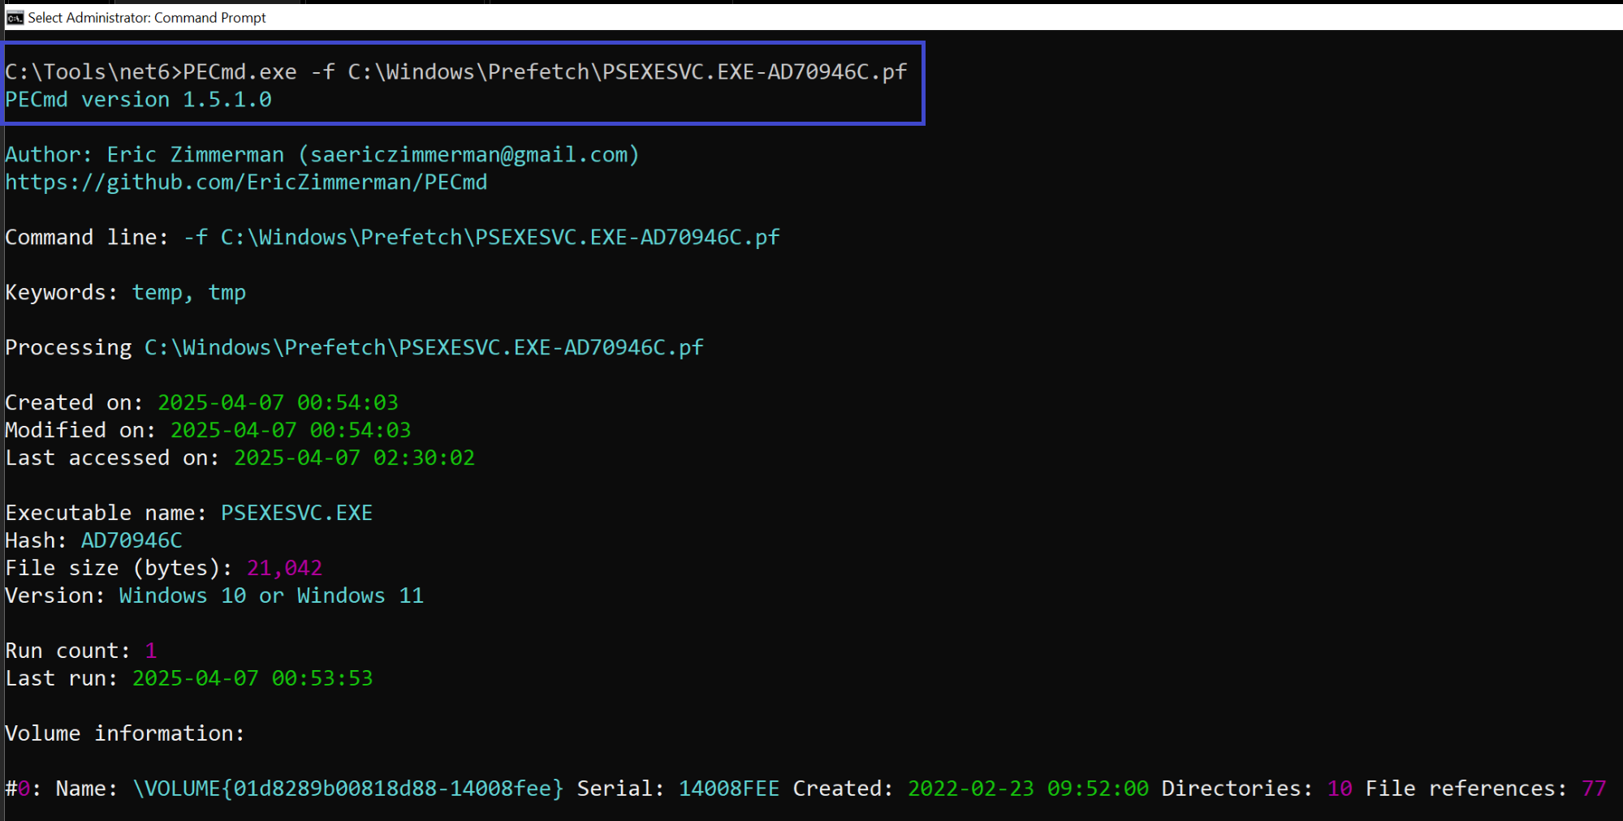
Interesting Noteworthy Detection Artifacts: PSExec
Use PECmd.exe (Another Eric Zimmermann Tool) to parse Prefetch files
Command:
PECmd.exe -f C:\Windows\Prefetch\PSEXESVC.EXE-AD70946C.pf

Slide 15
PsExec - Splunk Query Detection
Multiple Detection Avenues (Sysmon/Windows Event Logs):
7045: Service Creation with name like PSEXESVC (System Log)
5145: Network Share Objects checked for Access (Security Log)
13: Registry key set: “HKCU\Software\Sysinternals\PsExec\EulaAccepted”
11: PSEXESVC.exe file creation on target
1: Process execution by service
Sample Splunk Query:
index=main source="WinEventLog:Security"(EventCode=7045 AND ServiceName="PSEXESVC")OR (EventCode=5145 AND ShareName="\\*\\ADMIN$" OR ShareName="\\*\\C$"))OR (EventCode=13 AND TargetObject="*Sysinternals\\PsExec\\EulaAccepted")

Slide 16

Evil-WinRM: Remote Login and Pass-the-Hash
Authenticates using WinRM with plain credentials or NTLM hashes or Keys.
Connects to the target over WinRM using default ports (5985 for HTTP, 5986 for HTTPS).
Provides an interactive remote PowerShell shell to run commands.
Supports file uploads and downloads during the session.
Ends the session cleanly after commands finish executing.

Slide 17
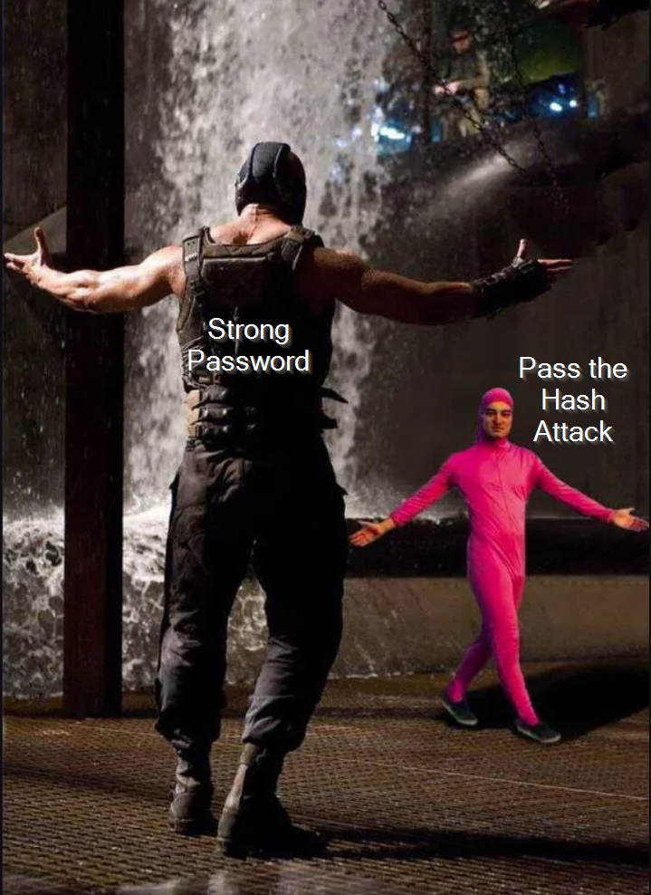

Slide 18
Evil-WinRM: Exploitation and Usage
Identify open ports: nmap -p 5985,5986 <IP>
Login with Credentials: evil-winrm -i <target_ip> -u <username> -p <password>
Login with NTLM Hashes: evil-winrm -i <target_ip> -u <username> -H <NTLM_Hash>
Login with certificates: evil-winrm -i <target_ip> -c <public-key-certificate> -k <private-key-certificate> -S
Upload and Downloads
PowerShell Session is obtained.
* -S option is used to transmit over SSL

Slide 19
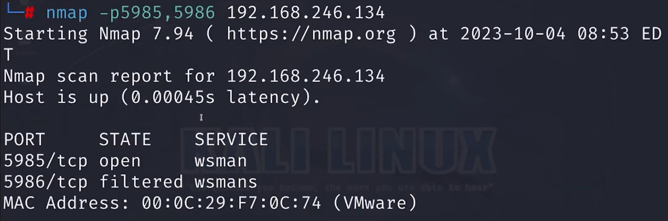
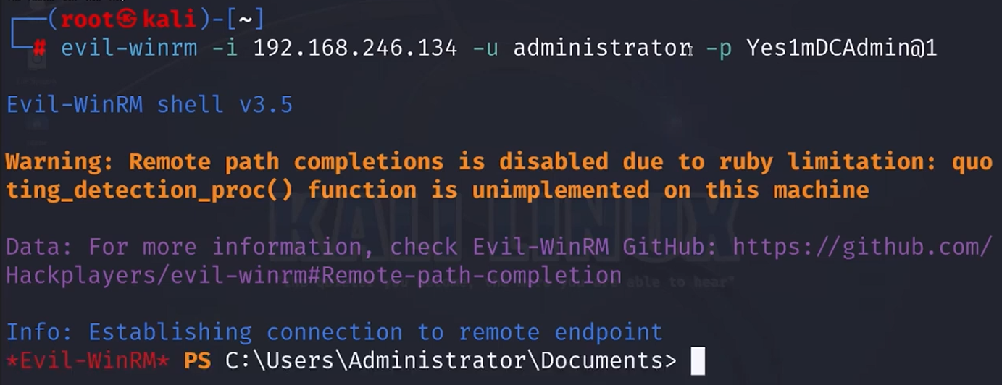
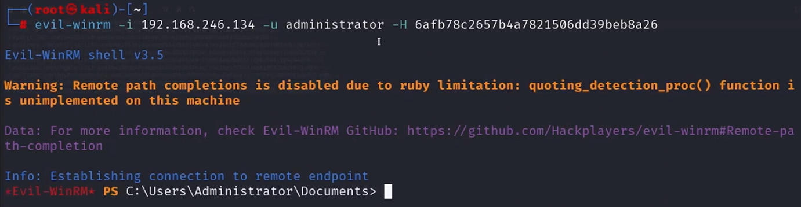
Source: https://www.youtube.com/watch?v=EWJM3tERMXs

Slide 20

Under the hood: How Evil-WinRM works
Connection: Evil-WinRM connects using WinRM with SOAP requests to the target’s /wsman endpoint.
Authentication: After successful login, it starts wsmprovhost.exe, which loads the PowerShell engine without showing a window.
Command Execution: Every command typed in Evil-WinRM is sent using PSRP, executed by the remote PowerShell engine, and returns the results.
Mechanism: It works just like PowerShell Remoting (using Enter-PSSession or Invoke-Command) by sending XML/JSON formatted commands.
Stealth: It uses the existing WinRM channel, so no extra services are created or new ports opened.

Slide 21
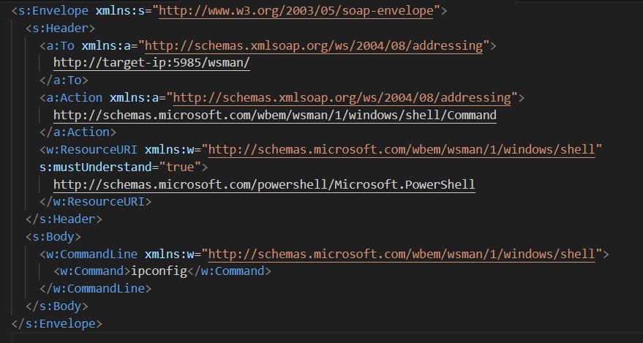
Sample SOAP request

Slide 22
Evil-WinRM: Artifacts
Logon events: Look for Event IDs 4624 or 4648.
PowerShell logs: Check IDs 4103 (module logging) and 4104 (script block logging) to see recorded commands.
Process evidence: wsmprovhost.exe
PowerShell history: Found at $env:APPDATA\Microsoft\Windows\PowerShell\PSReadLine\ConsoleHost_history.txt
Network logs: Monitor traffic on ports 5985 (HTTP) and 5986 (HTTPS) at the /wsman endpoint.

Slide 23
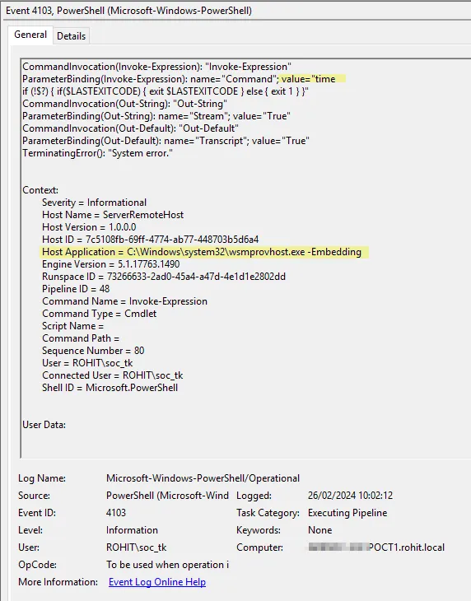
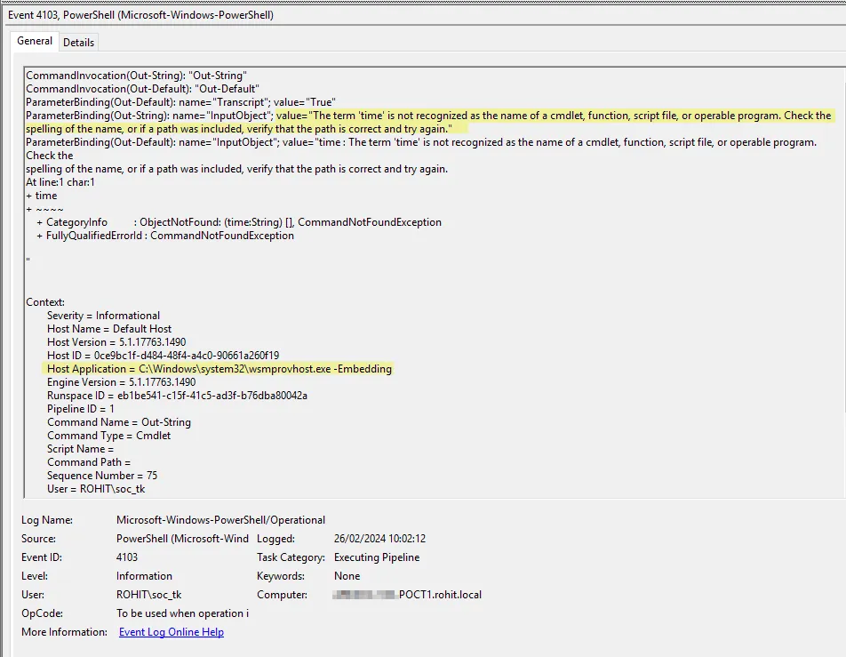
Source: https://medium.com/@cY83rR0H1t/evil-winrm-detection-de2874af7eb0

Slide 24
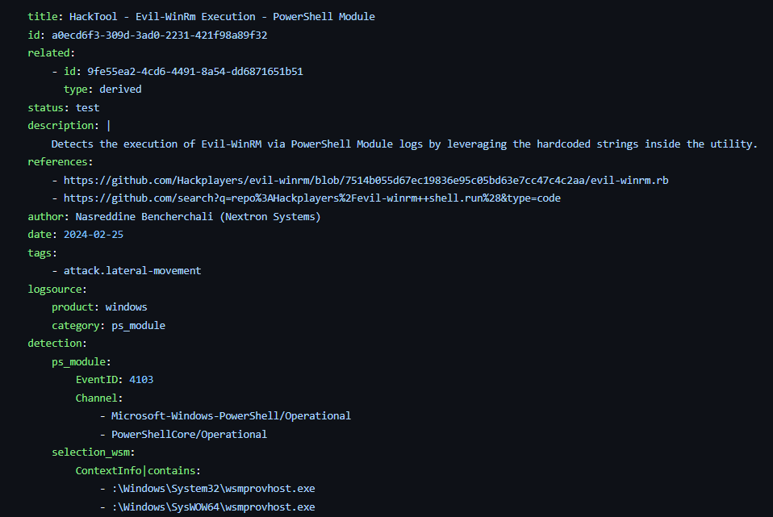

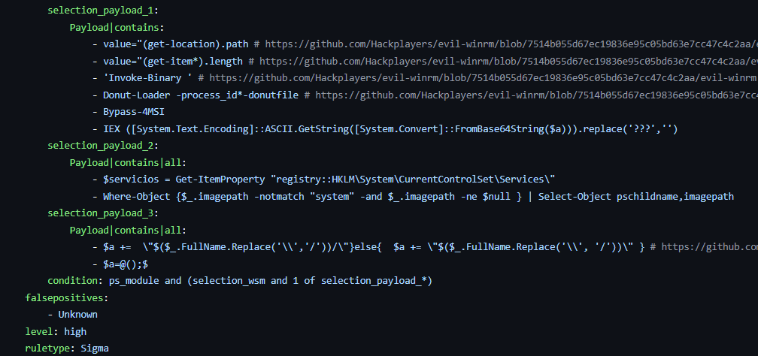
Source: https://github.com/Yamato-Security/hayabusa-rules/blob/main/sigma/builtin/powershell/powershell_module/posh_pm_hktl_evil_winrm_execution.yml

Slide 25
Disable Certificate Authentication
winrm set winrm/config/service/auth @{Certificate="false"}
Source: https://learn.microsoft.com/en-us/windows/win32/winrm/installation-and-configuration-for-windows-remote-management

Slide 26
Key takeaways
One Rule Doesn’t Catch All
Understanding that SharpHound has multiple variations, and each behaves differently so detection rules need to be adapted, not one-size-fits-all.
- Look Beyond the Logs
- Understanding that PsExec usage leaves multiple artifacts across different layers - system, network, services, and more - so detection can’t rely solely on Windows Event Logs or signature-based rules. Broader behavioral detection strategies are essential.

Slide 27
References
Bloodhound and SharpHound:
https://medium.com/mercadonait/how-to-hear-the-bloodhound-barking-5ac290427b17
https://ipurple.team/2024/07/15/sharphound-detection/
https://www.youtube.com/watch?v=_GJDkbUTSLY
PsExec:
https://aboutdfir.com/the-key-to-identify-psexec/
https://www.youtube.com/watch?v=VNacQn2XKLA
https://www.hackthebox.com/blog/how-to-detect-psexec-and-lateral-movements
https://app.hackthebox.com/sherlocks/Tracer
Yara & Sigma:
https://github.com/SigmaHQ/sigma
https://github.com/VirusTotal/yara
https://cyberdefenders.org/blueteam-ctf-challenges/yara-wizards/
https://cyberdefenders.org/blueteam-ctf-challenges/sigma-101/

Slide 28


